Slide 1
FuelMart & Subway Safety Committee Meeting
Wednesday, April 17, 2019
2:00 PM
Corporate Office Conference Room and GoTo Meeting Web Conference

Slide 2
1. Safety Topic – Construction Work Zone Awareness – Drive like you work here 2. Completing Incident Report Forms 3. Updated Injury packet Testing Instruction Forms (Revision date 03/19/2019) - Ohio and Non-Ohio updated forms for injury care and testing sleeves 4. Ladder inspection form and instructions updated (revision Date 04/02/2019) Note: Updated forms can be found on the Fuelmart document website www.fuelmart.com/docs.php
March 2019 Review:

Slide 3
Incidents and Injuries From 03/20/2019 to 04/16/2019

Slide 4
Employee Injuries:
Previous reported FM and Subway employee injury was on 01/29/19 – Subway employee sustained a burn to the arm from taking bread pan out of oven.
03/28/2019 – Subway employee doing dishes and knife was in sink water and cut employees hand. First aid treatment only. Corrective Action – do not leave knives in sink water at home or at work.
04/05/2019 – FM employee using box cutter, cutting towards themselves and cut stomach. First aid treatment only. Corrective Action – Always cut away from the body when using knives or box cutters at home or at work and only have the box cutter blade length long enough for the job task.
04/07/2019 – Subway employee cut finger on tomato slicer while washing it. First aid treatment only. Corrective Action – keep body parts away from sharp pieces, pay special attention to how you handle it while cleaning and utilize dishcloth as barrier between your you hand and the sharp pieces you are cleaning.
04/15/2019 – Subway employee using tomato slicer. Employee went to pick up a piece of tomato that fell by the blades and bumped a blade causing a cut to the finger. Corrective Action – Employee should have been wearing cut resistant gloves. Employee was re-trained.

Slide 5
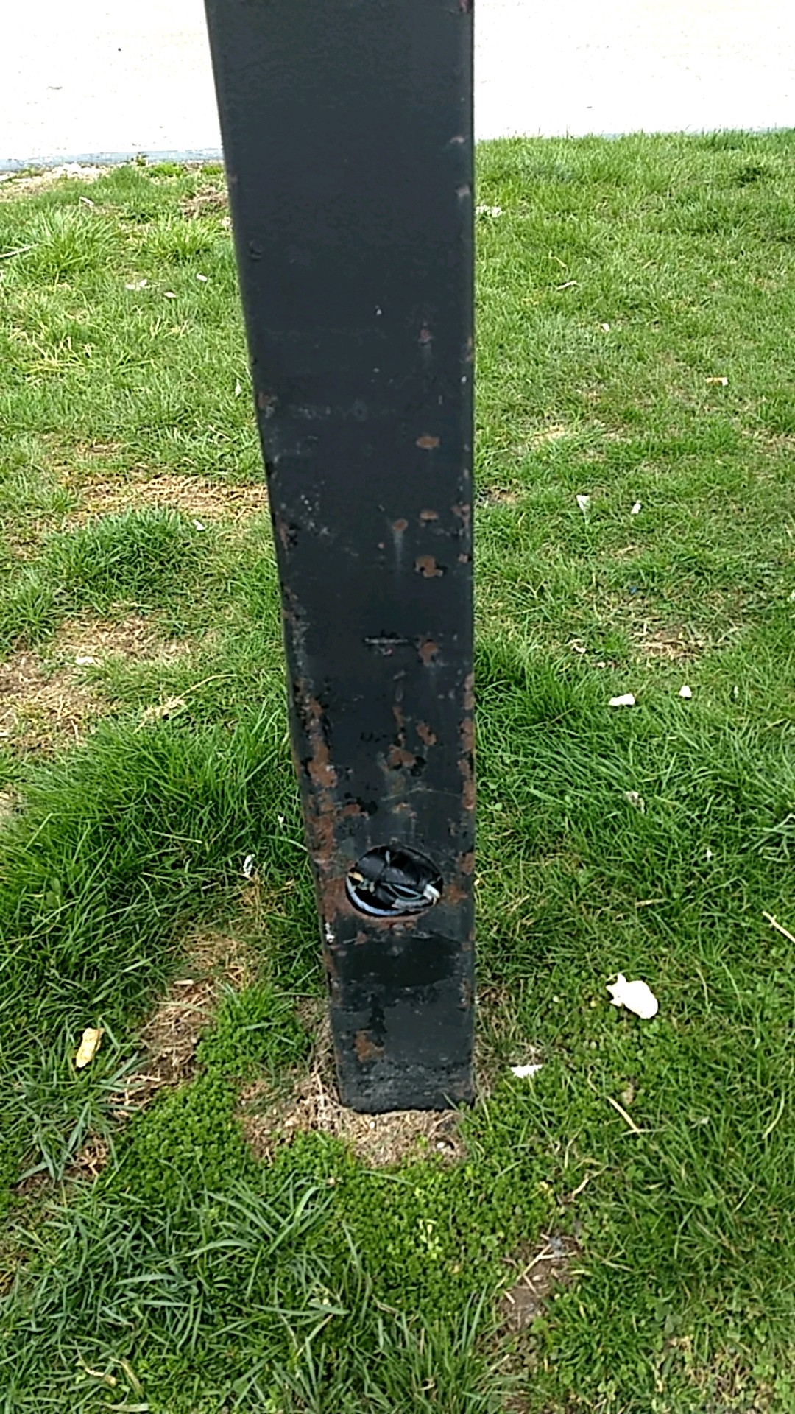
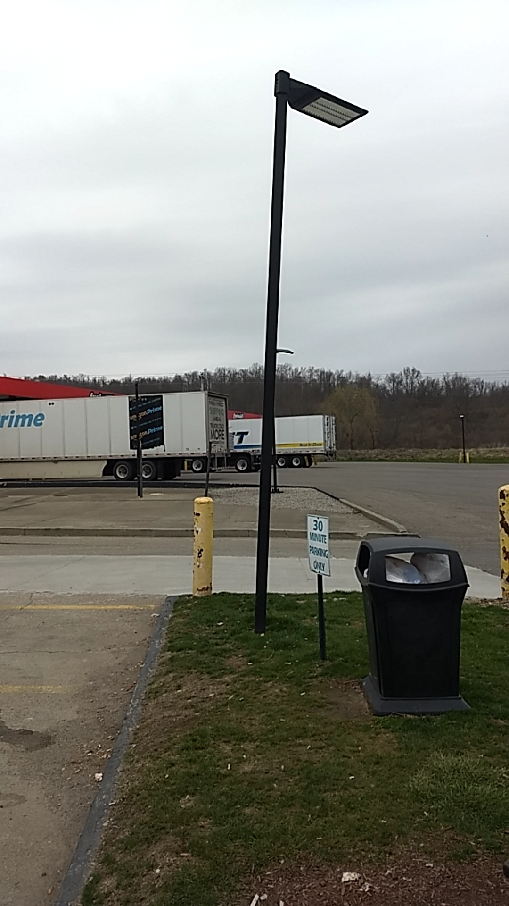
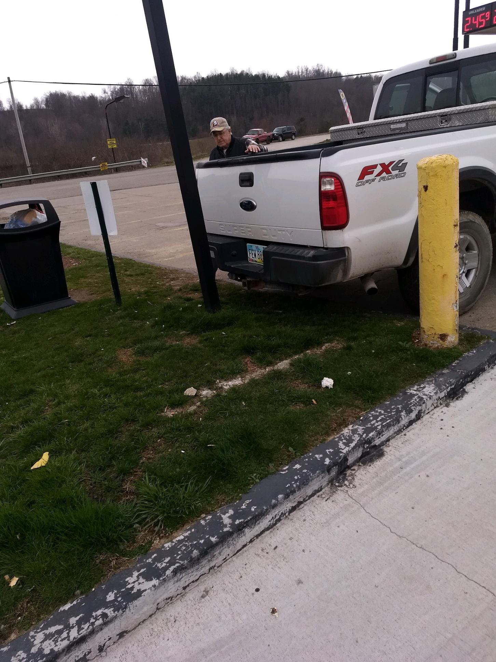
FM 727 FM Property Damage:
On 04/04/19 a customer in a pickup truck backed into a FM parking lot metal light post. Customer was uncooperative but FM was able to obtain insurance information. Insurance claim filed.

Slide 6
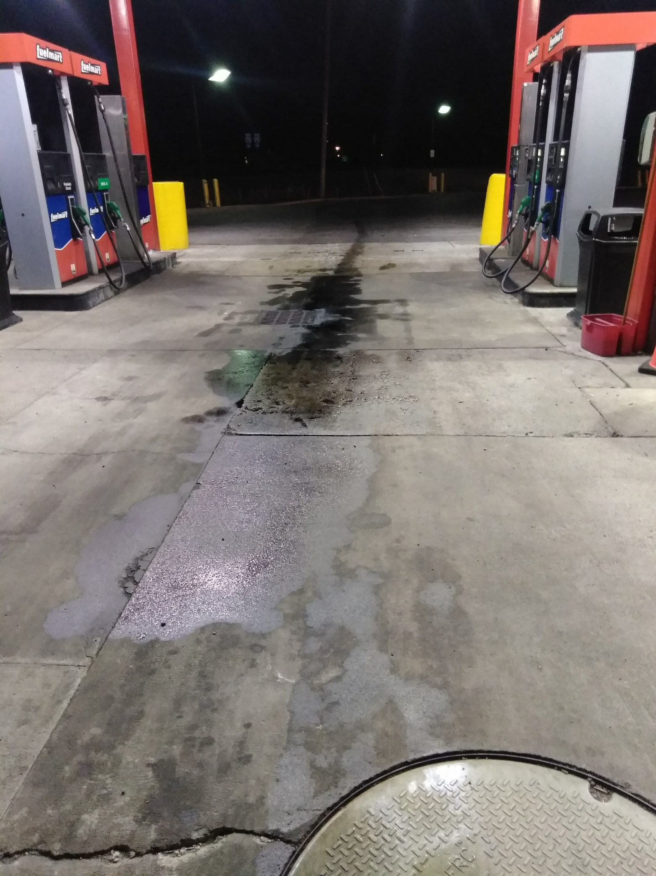
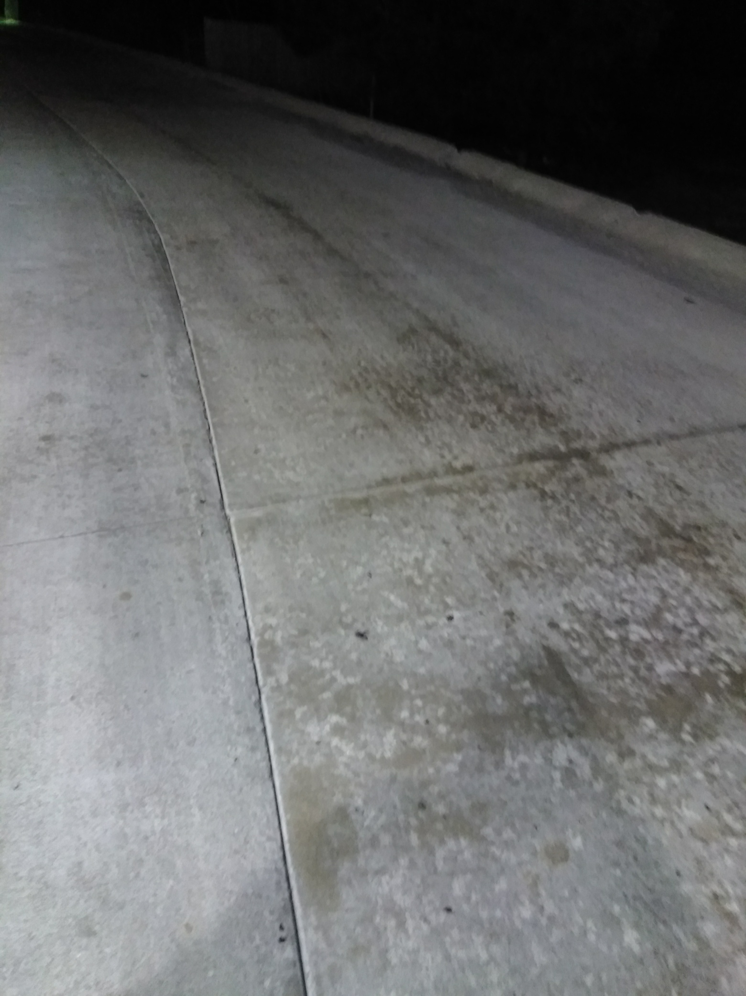
FM 782 diesel spill:
On 04/05/19 at 11:45 pm customer semi was leaking diesel at diesel pump.
On 04/06/2019 at 12:15 am FM employee was aware of a customer semi diesel spill at the diesel pump.
2:45 am Phillip L. notified of the diesel spill. Had employee start the process of obtaining driver and company information.
3:20 am decision made to contact EnviroServe to perform environmental remediation cleanup.
3:24 am made contact with Fire Chief.
3:36 am cancelled EnviroServe response.
3:48 am FM started cleanup with oil dry.

Slide 7
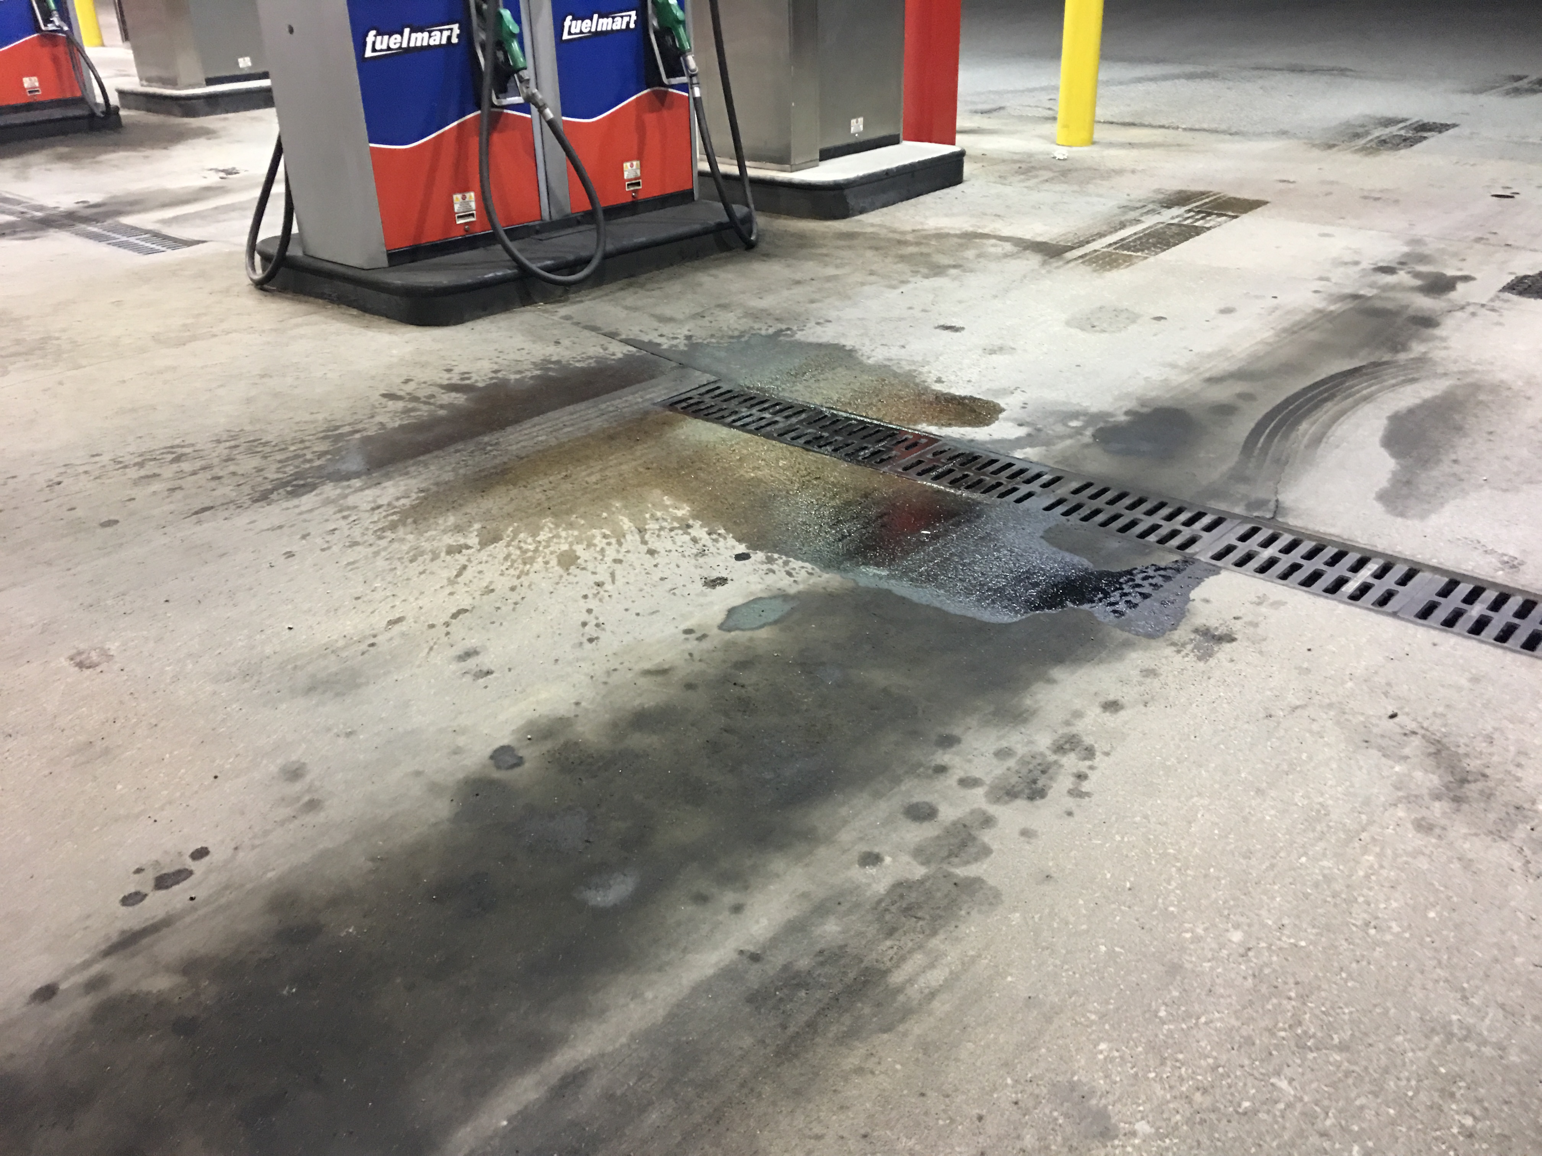
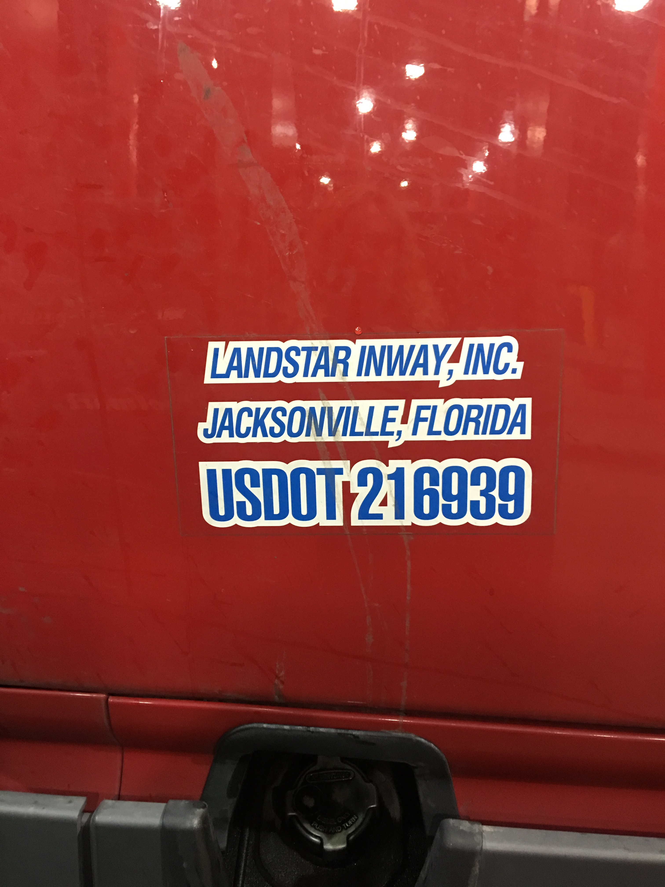
FM 783 diesel spill:
On 04/10/19 at approx. 6:00 am a customer was filling his semi diesel saddle tank on bay 6 and the nozzle fell out and remained on when it struck the ground. The driver pumped 35 gallons with approximately 10 gallons going into the saddle tank, 1 gallon spilled on the concrete and 25 gallons going into the oil / water separator. Once the customer noticed it he shut off the pump and went inside and informed a FM employee. Fortunately the nozzle fell on the drain limiting the size of the spill on the concrete. FM employees were able to clean the spill on the concrete. FM indicated the oil/water separator is pretty clean with hardly any fuel standing in it and they indicated it does not need to be pumped out at this time. FM employees took a lot of good photos (semi & trailer license plate, company info., DOT number, overall pictures standing back, etc.)

Slide 8
FM customer Incidents:
On 03/29/19 a customer was not feeling well and tripped on the curb, stumbled and fell. Ambulance was called. Customer refused medical treatment.
On 04/08/19 customer came inside store complaining of chest pain and abdomen pain and asked for an ambulance, which FM employee called. Customer was transported and ended up having emergency gallbladder surgery (personal health issue).
On 04/09/19 A female companion was with a male customer and she couldn't hold him up when he lost his balance. Customer fell. Another customer who witnessed the incident called 911. Customer refused medical treatment.

Slide 9
Date Range: Jan. 01, 2019 – April 16, 2019 Company Total Incidents: 64 (averaging 5 incidents per week) FuelMart & Subway Total Incidents: 33 (averaging 2 incidents per week) FuelMart & Subway employee injuries Reported: 10 FuelMart Property Damage and/or Vehicle Incidents: 6 FuelMart Customer Spills: 7 (5 at fuel pumps) FuelMart & Subway Customer injuries reported: 7 Other Incidents: 3

Slide 10
Safety Topics Utility Knives Safety Tips

Slide 11
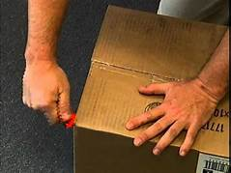
Utility Knives (Box Cutter) Safety Tips
Keep the blade sharp
Shorten the blade
Keep it covered
Angle it away from your body
Cut deliberately
Consider cutting half way
Keep your thumb away
Put your other hand away
Wear gloves
Changing blades

Slide 12
Open Floor Safety Questions / Concerns
Next Safety Committee Meeting is Wednesday, May 15, 2019 at 2:00 PM Eastern

